Slide 1
Heart Attack Prediction System
Project PPT by:-
Mohd Haris
2018-310-084
Under the supervision of
PROF. Gautami Tripathi

Slide 2
OBJECTIVE
Main Objective
The main objective of this is to predict heart attack by analyzing medical data set with the help of deep learning and neural network model.
Heart Attack Prediction System aims to exploit data mining techniques on medical data set to assist in the prediction of the heart diseases.
Specific Objective
• Provides new approach to concealed patterns in the data.
• Helps avoid human bias.
• Reduce the cost of medical tests.

Slide 3
INTRODUCTION
Data mining is the process of finding previously unknown patterns and trends in databases and using that information to build predictive models.
Data mining combines statistical analysis, machine learning, and database technology to extract hidden patterns and relationships from large databases
Heart Attack has been the leading cause of death in various countries.
In India more than 10 million cases per year are observed.
Diagnosis is a complicated and important task that must be performed accurately and efficiently
The diagnosis is often made based on the doctor's experience and knowledge.
This leads to undesirable results and excessive medical costs in treating patients, so an automated medical diagnostic system would be extremely beneficial.

Slide 4
Description of data attributes
1.Age : Age in years
2.Sex: Sex (0 : Female, 1: Male)
3.Cp: Chest pain (1 = typical angina; 2 = atypical angina; 3 = non-anginal pain; 4 = asymptomatic)
4.Trtbps: Resting blood pressure
5.Chol: Serum cholestoral in mg/dl
6.Bs: Fasting blood sugar > 120 mg/dl (1 = true; 0 = false)
7.Restecg: Resting electrocardiographic results (0 = normal; 1 = having ST-T; 2 = hypertrophy)
8.Thalachh: Maximum heart rate achieved
9.Exng: Exercise induced angina (1 = yes; 0 = no)
10.Oldpeak: ST depression induced by exercise relative to rest
11.Slp: The slope of the peak exercise ST segment (1 = upsloping; 2 = flat; 3 = downsloping)
12.Caa: The number of major vessels (0-3) colored by flourosopy
13.Thall : 3 = normal; 6 = fixed defect; 7 = reversable defect
14.Output : The predicted attribute - diagnosis of heart disease (0= less chance of heart attack 1= more chance of heart attack)

Slide 5
Proposed Architecture
In this system we are implementing an effective heart attack prediction system using Neural Network Model.
The data is provided in CSV file.
Then we will plot the data on graphs and then balance the unbalanced labels by using over- resampling method.
After resampling method, we use the z-normalization technique in order to scale the values. So that the variance in one and the standard deviation is 0.
Then the cross-validation technique is used to test the effectiveness of machine learning models.
The data is then split into the proportions of 80% train and 20% test.
After that algorithms is applied which is sequential neural network model.
we will have results with promising accuracy.

Slide 6
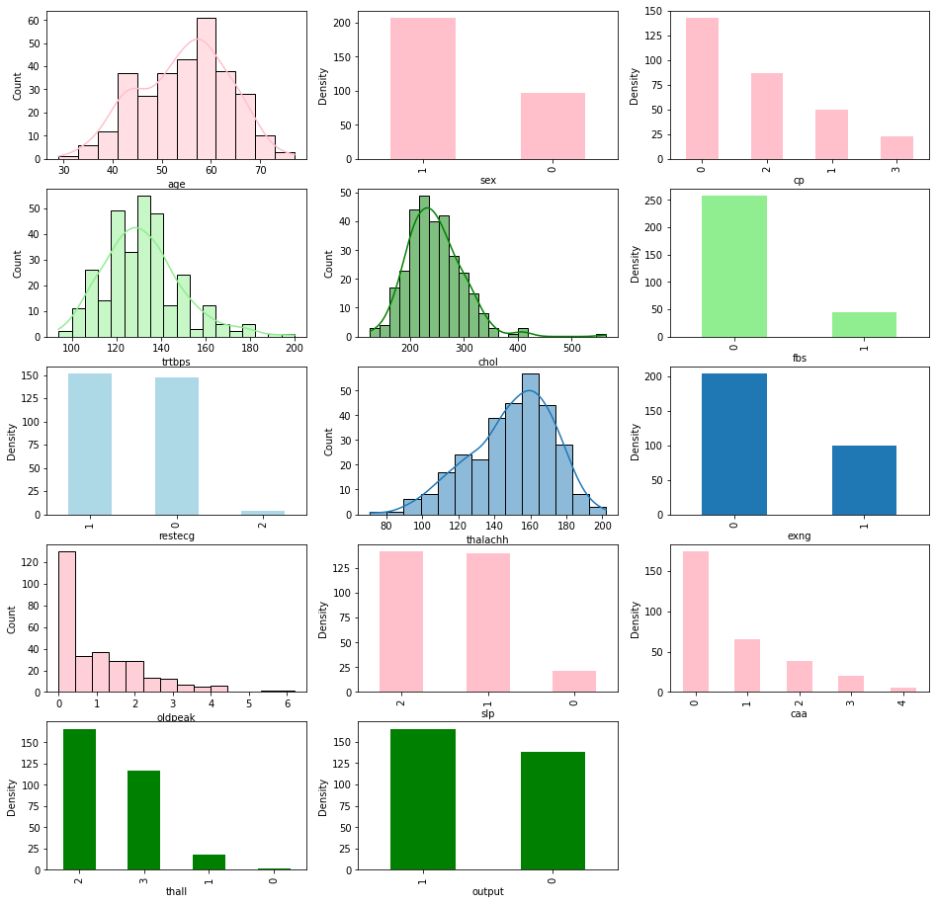
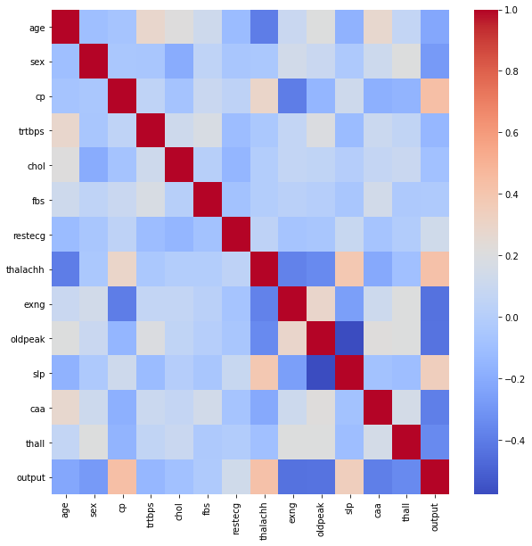
Visualization of Data
Heat map for attribute

Slide 7
Neural Network Model
A sequential neural network model is used .
We have different fully connected layers that are the size of 32,64,128,128, and 1 respectively.
The model is compiled using adam optimizer, loss function and accuracy metric. We benefited from the early-stopping function to stop training when accuracy is not improved 20 consecutive times.
We reduced the leaning rate when a metric has stopped improving 5 consecutive times.
For the fitting model, 28 batch size and 200 epochs is used. Also, the model evaluated the test data.
The accuracy achieved is 92 % .

Slide 8
Scope and Limitation
Scope
Integrating clinical decision support into computerized patient records could reduce medical errors, improve patient safety, reduce undesirable deviations in practice, and improve patient outcomes, and improve the quality of clinical decisions.
Limitation
Medical diagnosis is considered an important but complex task that must be performed accurately and efficiently; automation would be very beneficial. Clinical decisions are often made based on the intuition and experience of the clinician, rather than the knowledge-rich data hidden in that practice. Data extraction has the potential to create a knowledge environment that can help significantly improve the quality of clinical decisions.

Slide 9
References
Cutsuridis, V. and Perantonis, S., 2006. A neural network model of Parkinson's disease bradykinesia. Neural Network
Wang, N., Chen, J., Xiao, H., Wu, L., Jiang, H. and Zhou, Y., 2019. Application of neural network model in diagnosis of Alzheimer’s disease. BMC neurology, 19(1), pp.1-8.s, 19(4), pp.354-374.
https://archive.ics.uci.edu/ml/datasets/Heart+Disease.

Slide 10
THANK YOU

